Slide 1
Project Presentation D2_GROUP_01
Microprocessor, Interfacing and
System design Lab- EEE3210

Slide 2
Smart Door Lock System : Built with a Keypad PIN and RFID Door Lock Sensor

Slide 3

OUR TEAM – Member 01
Md. Naimul Islam
ID- 20200105218
D2_Group01

Slide 4

OUR TEAM – Member 02
Tasdik Hossain
ID- 20200105220
D2_Group01

Slide 5

OUR TEAM – Member 03
Humayra Tabassum
ID- 20200105221
D2_Group01

Slide 6

OUR TEAM – Member 04
Nasif Zawad
ID- 20200105222
D2_Group01

Slide 7

OUR TEAM – Member 05
Israt Jahan Ena
ID- 190205075
D2_Group01

Slide 8
TABLE OF CONTENTS
01
02
Introduction
05
User Interface
Components Used
06
Challenges Faced
03
Working Principle
07
Applications
04
Code Overview
08
Future Enhancements

Slide 9
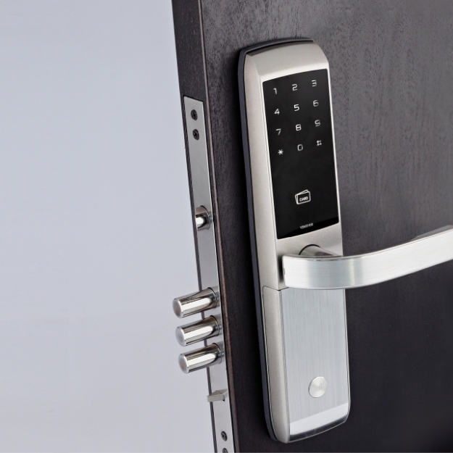
Introduction
This presentation will cover the process of building a secure access control system using an Arduino Uno microcontroller, a keypad, and an RFID reader. The system will allow authorized personnel to enter a room using a PIN code or an RFID tag. This system is ideal for securing offices, labs, or any other restricted area.

Slide 10
Components List
Arduino Uno | Microcontroller board used for program execution and control of electronic components. (Master and Slave)
Keypad: RFID Reader: Breadboard: LED: LCD Monitor: Solenoid Lock: 5V Relay: 12 Volt Adaptor | Input device with buttons for entering PINs or data. Device for reading data from RFID cards/tags to enable secure access. Platform for prototyping and connecting electronic components.. Light-emitting diode that emits light when current flows through it. Liquid Crystal Display for visual output of information. Electromagnetic device that controls the locking mechanism. Electrically operated switch used to control higher voltage/current devices. Power supply providing a 12V DC voltage to the system.

Slide 11
Working Principle

Slide 12
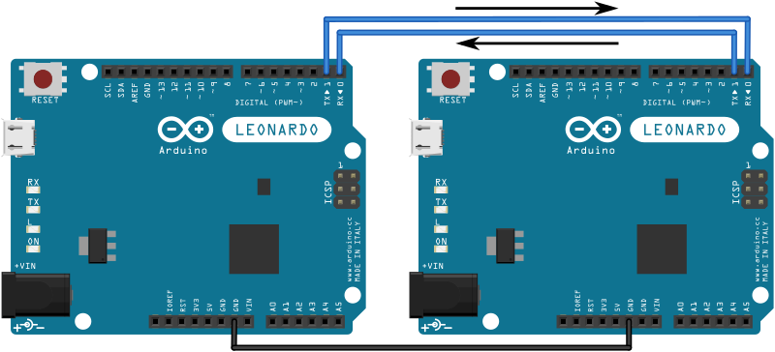
Circuit Diagram (Master- Slave connection)

Slide 13
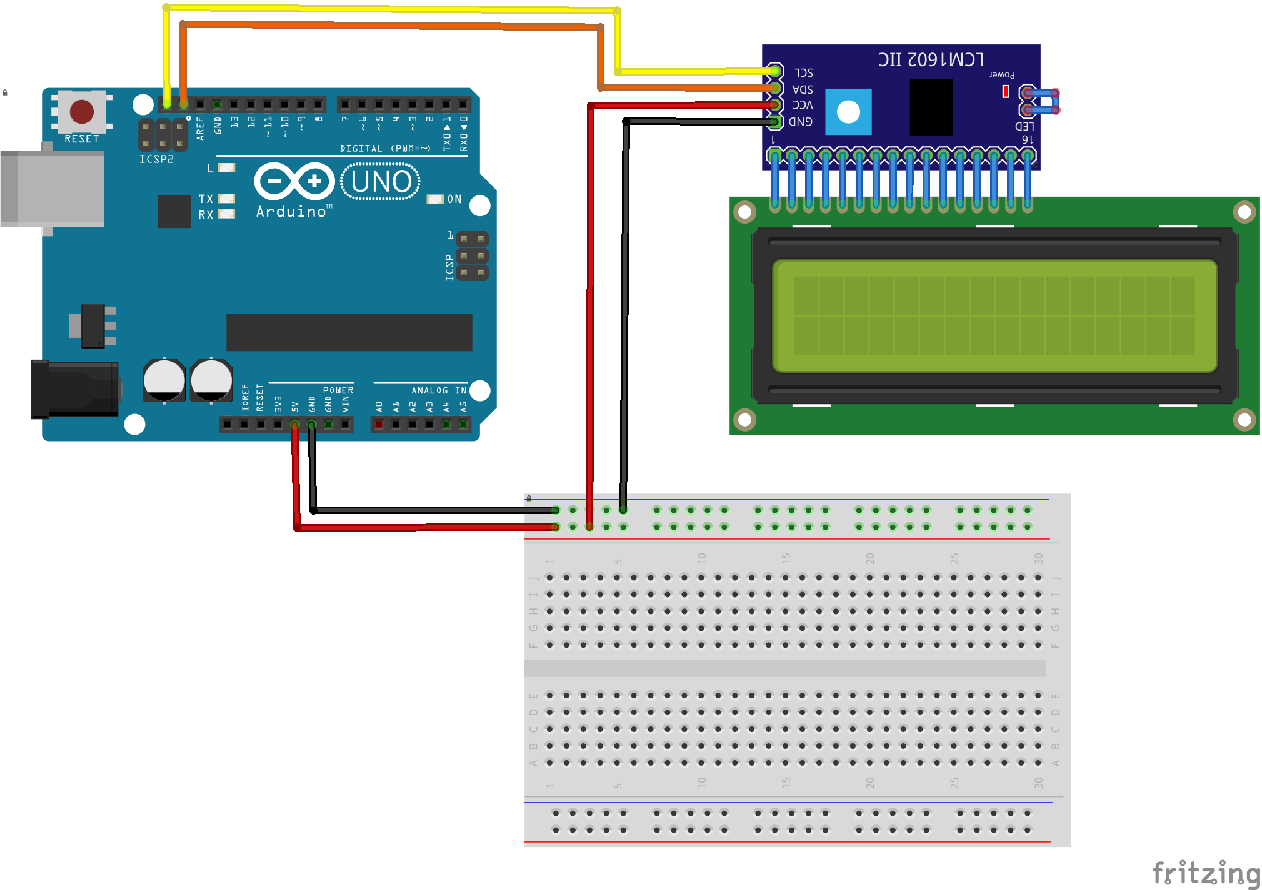
Circuit Diagram (Master side- LCD connection)

Slide 14
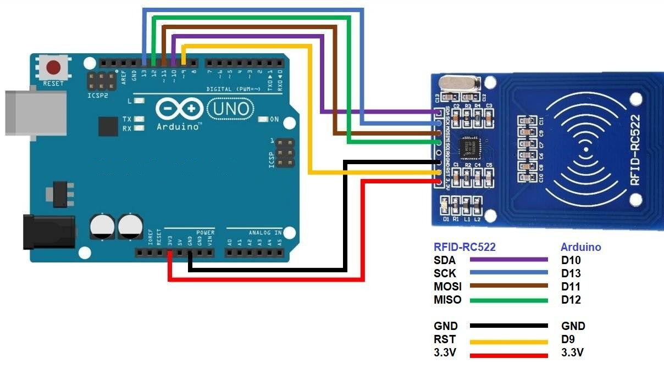
Circuit Diagram (Master side- RFID connection)

Slide 15
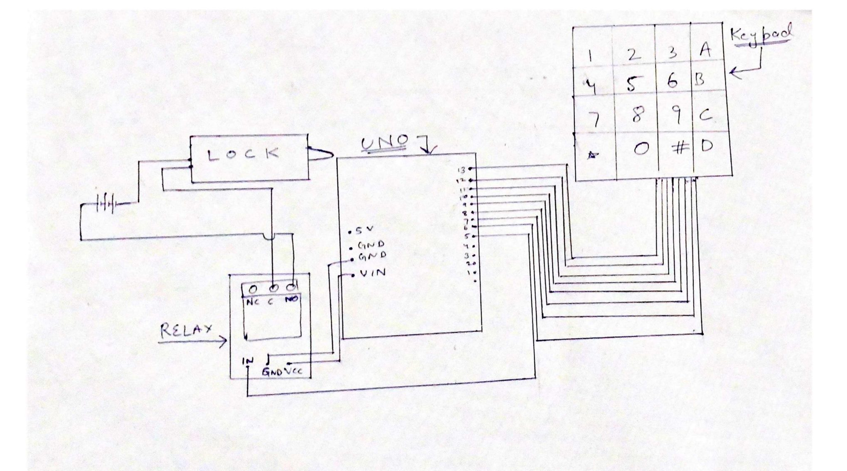
Circuit Diagram (Slave side- Keypad connection)

Slide 16
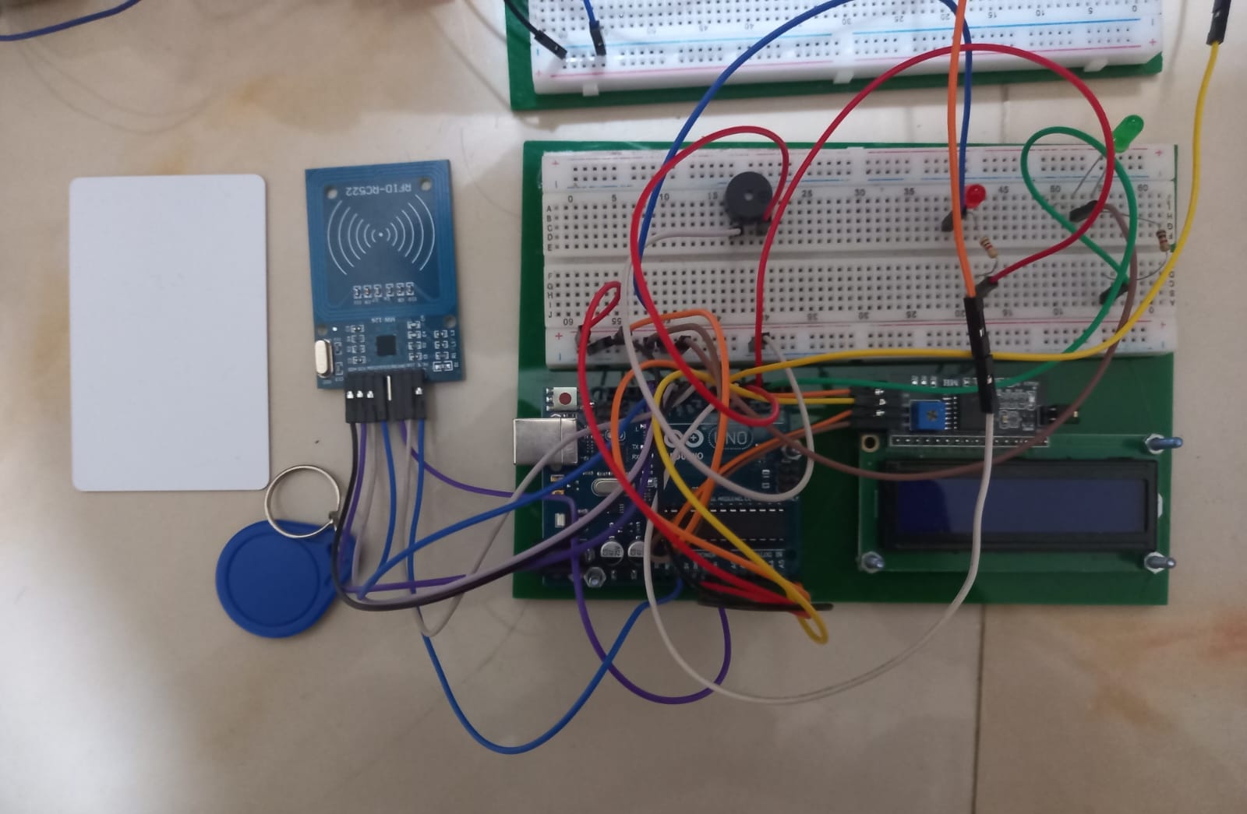
RFID Reader
Device for reading data from RFID cards/tags to enable secure access.

Slide 17
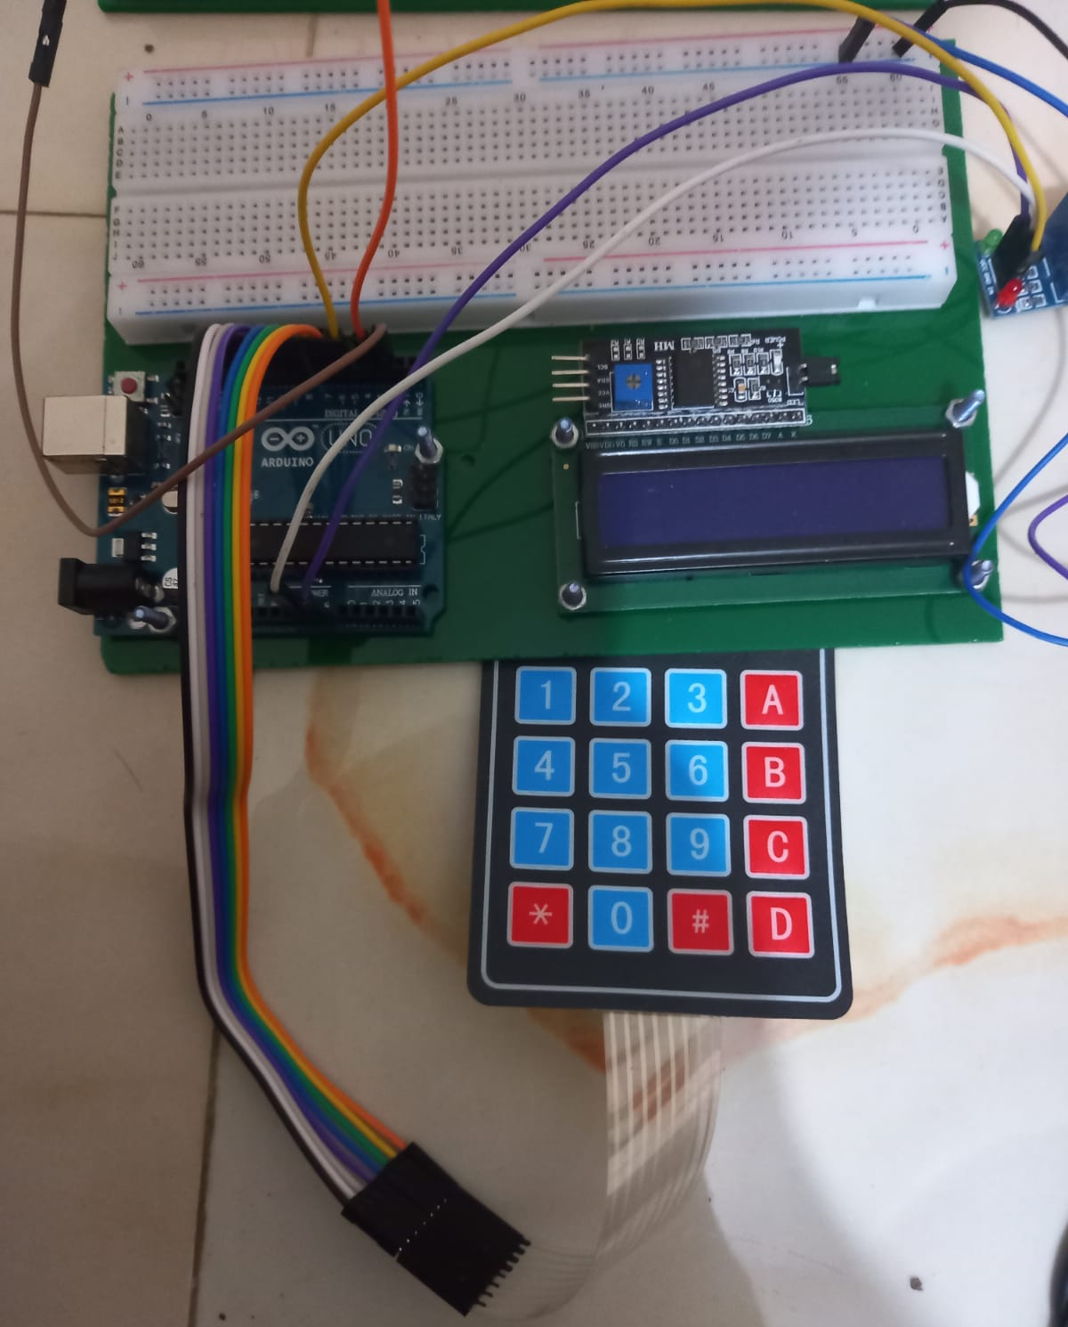
Keypad
The user approaches the door and is prompted to enter a PIN on the keypad.A message on the LCD display instructs the user to input the PIN.

Slide 18
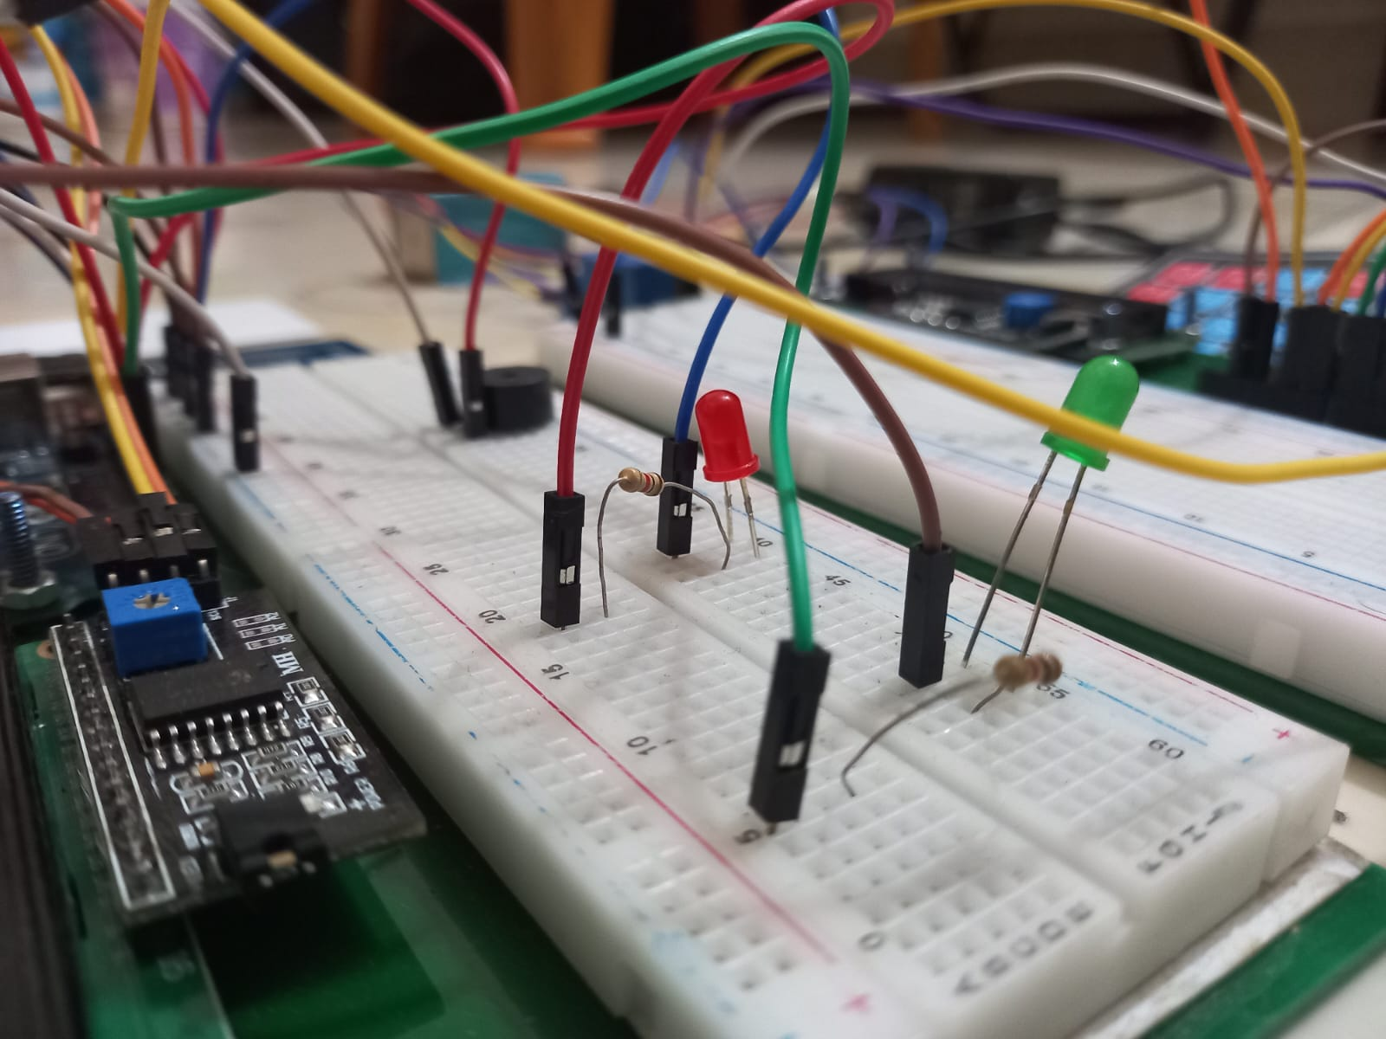
Buzzer and LED
A buzzer and LED module is a compact electronic component that combines an audible buzzer and a visual LED indicator, commonly used for providing audio and visual alerts in various applications.

Slide 19
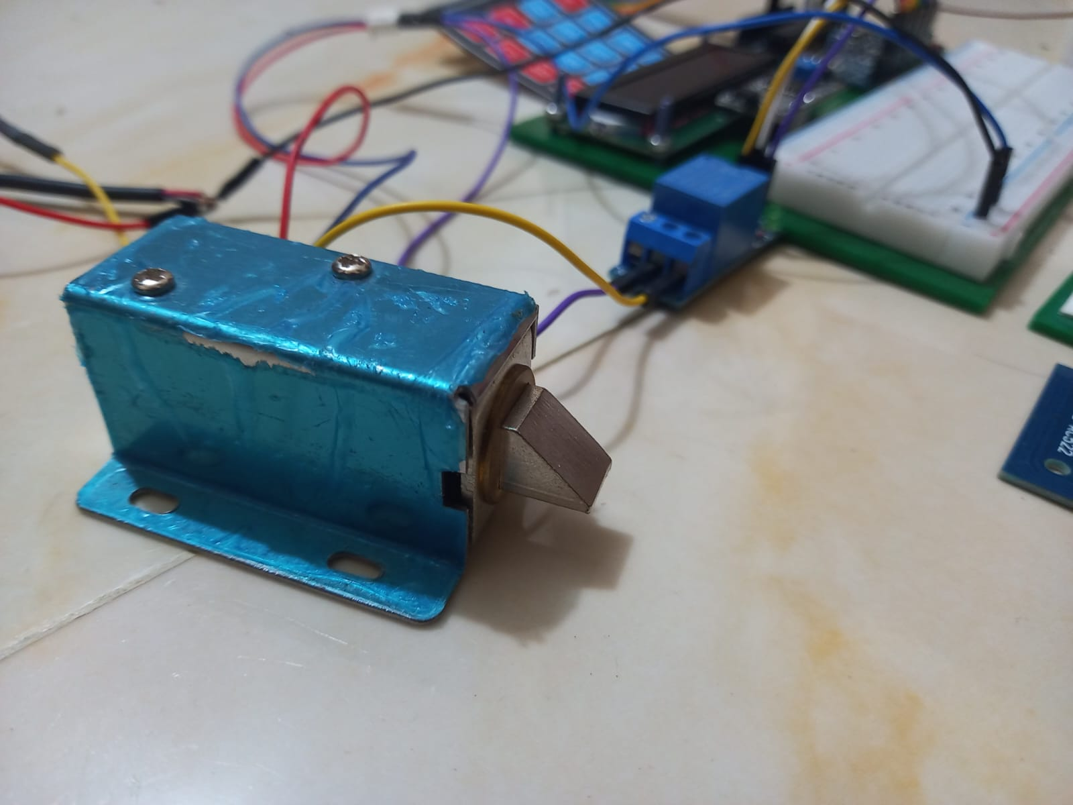
Solenoid Lock
Electromagnetic device that controls the locking mechanism.

Slide 20
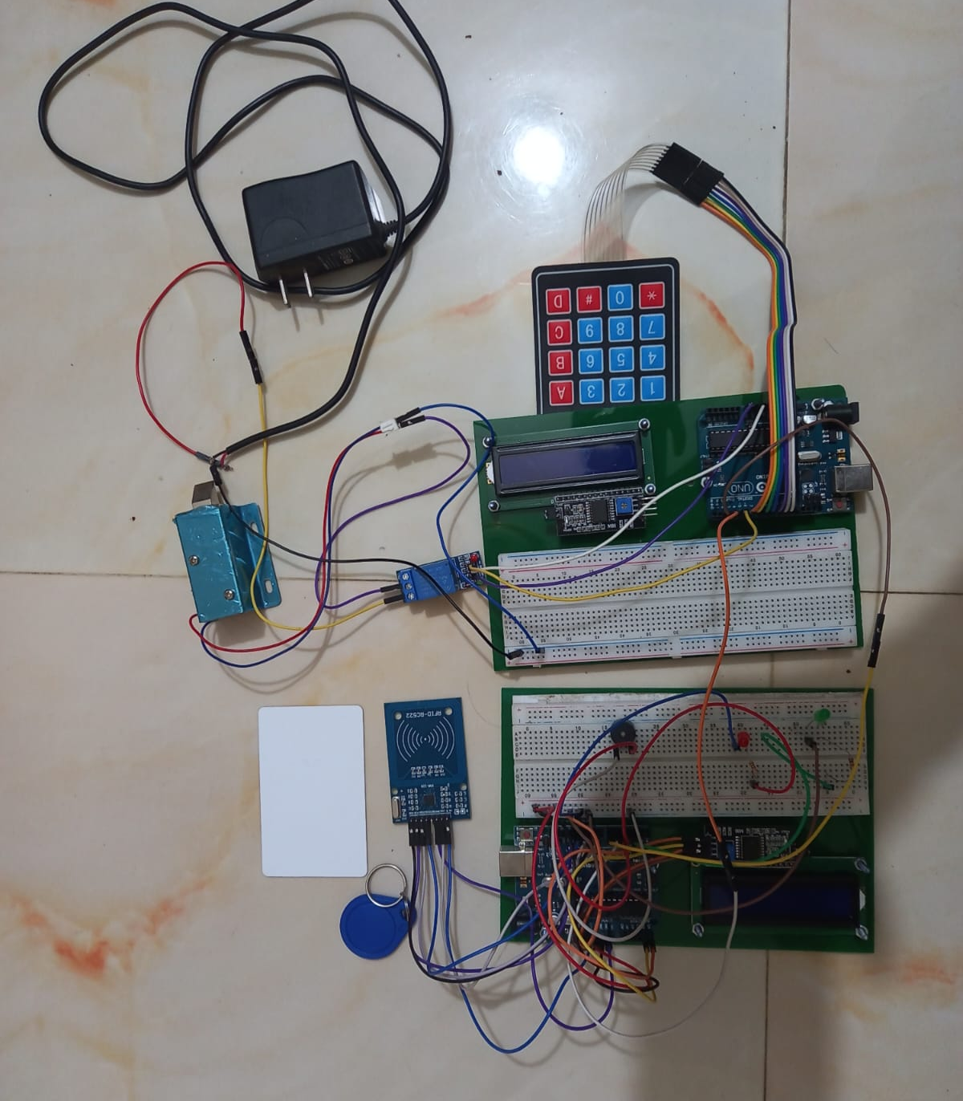
Full Circuit Setup

Slide 21
Operating Principle
01 | RFID Detection & Authentication | 05 | Security Measures
02 | Access Granted Indication: | 06 | Emergency Unlocking
03 | Keypad PIN Entry | 07 | Power Management
04 | Feedback Display | 08 | Integration of Components

Slide 22
Challenges Faced

Slide 23
User Interface
Keypad Interaction
PIN Entry
Validation Feedback
PIN Validation Result
RFID Card Scanning
RFID Card Detection
Access Granted
Access Denied
System Status Display
Emergency Unlock Option
Visual Feedback
Reset or Retry Instructions

Slide 24
Challenges
01 | Component Integration | 05 | Testing and Debugging
02 | Code Complexity | 06 | Compatibility and Libraries
03 | RFID Detection Reliability | 07 | Authentication Logic
04 | Power Management

Slide 25

Future Enhancements

Slide 26
Mobile App Integration
Camera Integration
User Profiles and Access Levels
Multiple Door Control
Biometric Authentication
Voice Commands:

Slide 27
Code Overview

Slide 28

Master Side Code _Part1
//Arduino Door Lock Access Control Project
//Master
#include <SPI.h>
#include <MFRC522.h>
#include <LiquidCrystal_I2C.h>
#include <SoftwareSerial.h>
SoftwareSerial masterUno(6, 7); // RX, TX
String data;
bool isMatch;
#define SS_PIN 10
#define RST_PIN 9
// Instance of the class MFRC522
MFRC522 rfid(SS_PIN, RST_PIN);
// Create LCD object : Use 0x27 If 0x3F Doesn't work
LiquidCrystal_I2C lcd(0x3F, 16, 2);
// Init array that will store new NUID
byte nuidPICC[4];
// Put Your access NUID Here
byte master[4] = {0x53, 0x9B, 0xB2, 0x0E};

Slide 29
Master Side Code _Part2
// Pin connected to lock relay signal
#define lockOutput 2
#define greenLED 3
#define redLED 4
#define buzzerPin 5
void setup() {
Serial.begin(9600);
masterUno.begin(9600);
SPI.begin(); // Init SPI bus
rfid.PCD_Init(); // Init MFRC522
// Setup LCD with backlight and initialize
lcd.init();
lcd.backlight();
printWelcomeMessage();
// Set OUTPUT pins
pinMode(lockOutput, OUTPUT);
pinMode(greenLED, OUTPUT);
pinMode(redLED, OUTPUT);
pinMode(buzzerPin, OUTPUT);
}

Slide 30

Master Side Code _Part3
void loop() { // Reset the loop if no new card present on the sensor/reader
if ( ! rfid.PICC_IsNewCardPresent())
return; // Verify if the NUID has been readed
if ( ! rfid.PICC_ReadCardSerial())
return; // Store NUID into nuidPICC array
for (byte i = 0; i < 4; i++) {
nuidPICC[i] = rfid.uid.uidByte[i];
} // Checks whether the scanned tag is authorized
if (getAccessState(master, nuidPICC) == true) {
lcd.clear();
lcd.setCursor(0, 0);
lcd.print(" Access Granted!");
isMatch = 1 ; // Send true or false to slave
masterUno.write(isMatch);
// Turn on relay & green LED for 5 seconds
digitalWrite(greenLED, HIGH);
delay(4000);
digitalWrite(greenLED, LOW);
delay(25); //To fix (LCD, Solenoid) issue
printWelcomeMessage(); } else {
lcd.clear();
lcd.setCursor(0, 0);
lcd.print(" Access Denied!");
isMatch = 0 ;

Slide 31
Master Side Code _Part4
// Send true or false to slave
masterUno.write(isMatch);
digitalWrite(redLED, HIGH);
digitalWrite(buzzerPin, HIGH);
delay(1000);
digitalWrite(redLED, LOW);
digitalWrite(buzzerPin, LOW);
printWelcomeMessage();
}
// Halt PICC
rfid.PICC_HaltA();
// Stop encryption on PCD
rfid.PCD_StopCrypto1();
}
bool getAccessState(byte accessCode[], byte newCode[]) {
for (byte i = 0; i < 4; i++) {
if (newCode[i] != accessCode[i]) {
return false;
}
}
return true;
}
void printWelcomeMessage() {
lcd.clear();
lcd.print("<Access Control>");
lcd.setCursor(0, 1);
lcd.print(" Scan Your Tag!");
}

Slide 32
I2C Master-Slave Connection
Slave
Master
Keypad Connection
SCL
SDA
LCD, RFID Connection
Vcc

Slide 33
Slave Side Code _Part1
//Slave
#include <Keypad.h>
#include <SoftwareSerial.h>
SoftwareSerial slave(2, 3); // RX, TX
bool isOn;
char * password = "3690"; // To increase the passcode length change the numerical to the size after position
int position = 0;
const byte ROWS = 4; // 4 rows
const byte COLS = 4; // 4 columns char keys[ROWS][COLS] =
{
{'1','2','3','A'},
{'4','5','6','B'},
{'7','8','9','C'},
{'*','0','#','D'}
};
//mapping of the keys done w.r.t to the grid keypad
byte rowPins[ROWS] = { 13, 12, 11, 10 }; //connection of rows pins to the arduino
byte colPins[COLS] = { 9, 8, 7, 6 }; // connection of the columns pins to the arduino
Keypad keypad = Keypad( makeKeymap(keys), rowPins, colPins, ROWS, COLS );
int Lock = 5; // Connecting the relay to the 5th pin

Slide 34
Slave Side Code _Part2
void setup()
{
Serial.begin(9600);
slave.begin(9600);
pinMode(Lock, OUTPUT);
LockedPosition(true);
}
void loop()
{
// Wait for master to send data
while (slave.available() == 0)
{
char key = keypad.getKey();
if (key == '*' || key == 'A') //OR operator used to lock the device back again
{
position = 0;
LockedPosition(true);
}
if (key == password[position])
{
position ++;
}
if (position == 4) // change this if you want to increase the password length
{
LockedPosition(false);
}
delay(100);
}

Slide 35
Slave Side Code _Part3
// Read data from master
isOn = slave.read() ;
// Execute code based on data
if (isOn)
{
digitalWrite(Lock, HIGH);
}
else
{
digitalWrite(Lock, LOW);
}
}
void LockedPosition(int locked)
{
if (locked)
{
digitalWrite(Lock, LOW);
}
else
{
digitalWrite(Lock, HIGH);
}
}
==========

Slide 36
Applications

Slide 37
Applications
Residential Security
Laboratories
Industrial Sites
Office Access
Healthcare Facilities
Financial Institutions

Slide 38
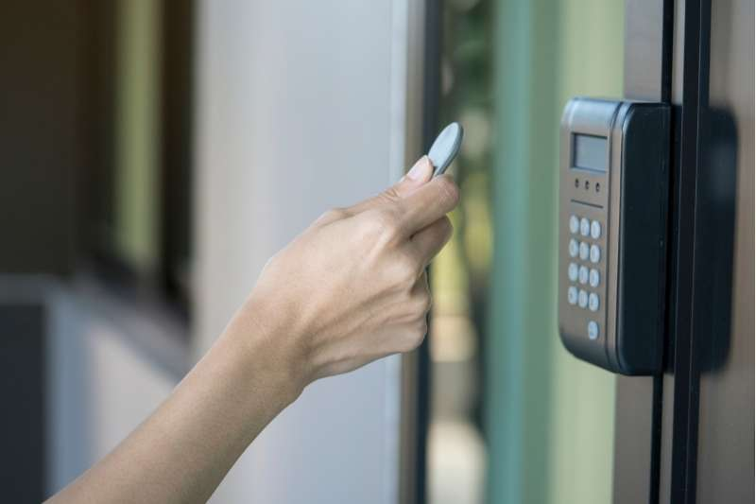
Residential Security

Slide 39

Laboratories

Slide 40

Industrial Sites

Slide 41
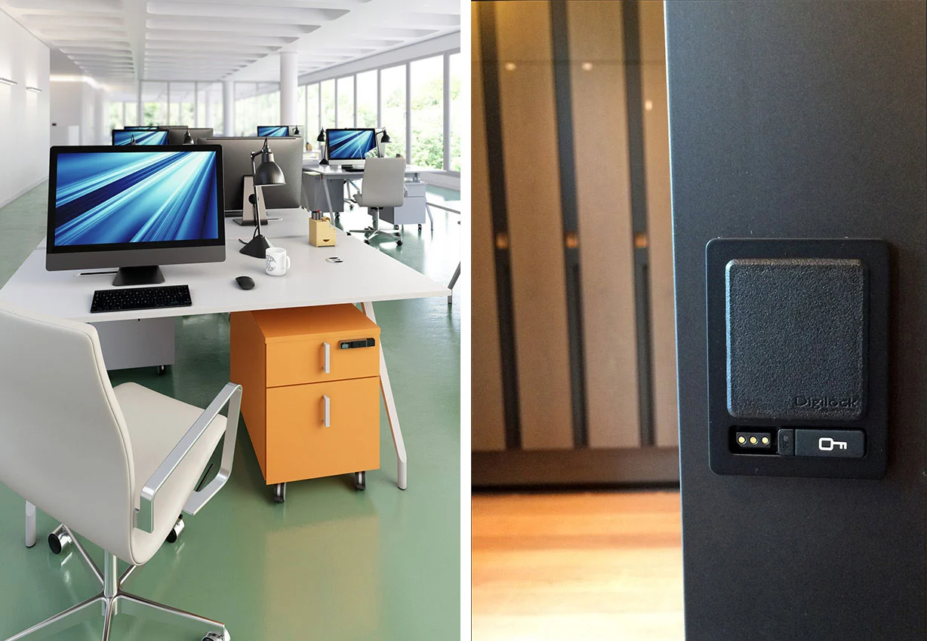
Office Access

Slide 42

Healthcare Facilities

Slide 43

Financial Institutions

Slide 44
Conclusion
This project effectively showcases a robust and secure access control mechanism. By combining keypad PIN entry and RFID authentication, along with the power of Arduino Uno, the system ensures reliable and multi-factor access. This innovative solution holds great potential for enhancing security in various applications, from residential spaces to office environments.

Slide 45




